Slide 1
Instructions for Visualization and Analysis Demos
You have 3 minutes to present – be ready to share your screen, practice first. We can only offer you one opportunity to present. Present your slides in “Slide Show” mode. Presentations will take place during the module Tutorial slots (see Canvas Announcements for links to join Tutorials via Teams).
The next few slides give you all the alternatives for how to present your Visualizations. You will select only one as fits your RQ. Before presenting DELETE all text (and instructions) that you do not use (including this slide). You can then enlarge your selection, so it is clearly visible on the slide.
Appointment slots will appear on Canvas soon (calendar-7com1079-24). Sign up early. When space runs out, we cannot issue any further slots for this week. If you do not turn up for your slot you will not be given another opportunity. Ideally, all the group members should attend but select one person to present. DO NOT SIGN UP unless one of your group can attend and present. You will not be graded on this.
We look forward to giving you feedback. If your group is not presenting, still attend the tutorial as the feedback will help you too.
¹At this point we assume you are using your allocated datasets (see group-dataset allocations on Slack Announcements). Any changes to the Kaggle/Data.world csv/xlxs file you make such as merges, grouping, or size reduction must be done via an R script, not manually, not in excel.

Slide 2
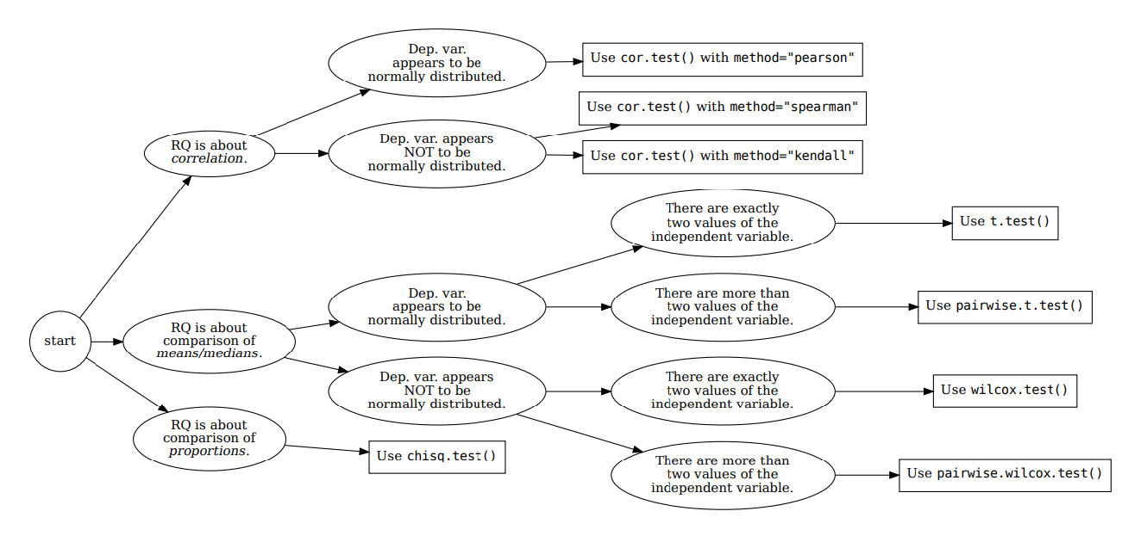







How your RQ + distribution of data (Histogram) leads to a statistical test. Visualization requirements highlighted in yellow.
Histogram & Scatterplots
Histogram and Boxplots
Stacked bar chart (no histogram)
Figure: Decision tree – how Research Questions relate to Visualizations and Statistical Test.

Slide 3

Visualization and Analysis –
Tutorial Presentation for Feedback
Date:
Group Id: Name of Student Presenting:

Slide 4
If you have not defined your Research Question (RQ) yet, please do not attempt to present Visualizations and/or analyses of your data. Go to Canvas, announcements on RQ presentations, and use the PowerPoint template provided for you to present your RQ. You can use the time slot to present your RQ instead of the Visualisation.
Part 1: VISUALISATION

Slide 5
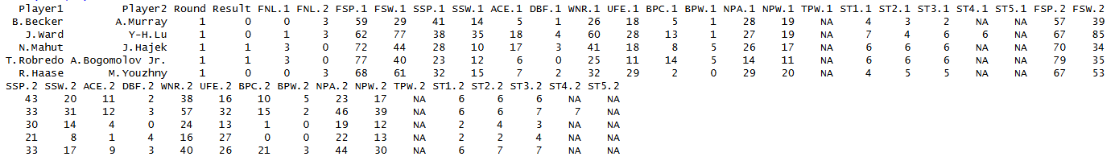
We are using the dataset (DS 015, Wimbledon men 2013.csv) to answer our Research Question “ (Is there a correlation between the points won in second serve and the points won in first serve ”
Independent Variable is First serve won
Dependent Variable is Second Serve won

Slide 6
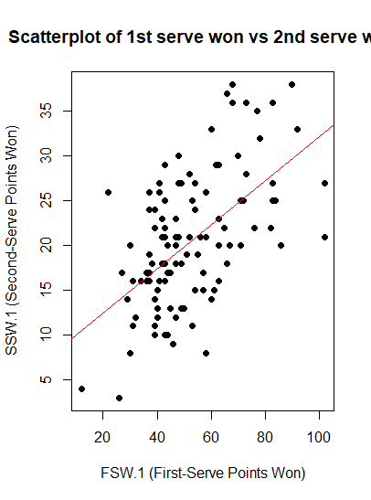
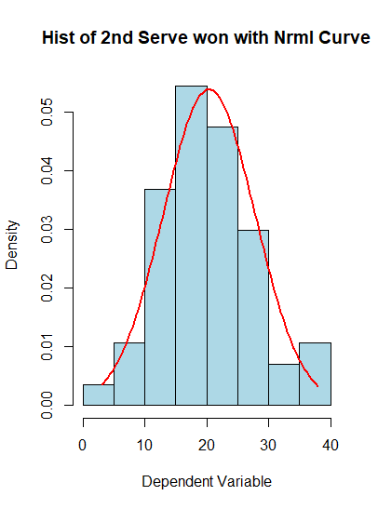
1. Where your research question asks about Correlation: Include two visualizations
Correlation analyses how an interval/ratio dependent var correlates to an ordinal/interval/ratio independent variable

